Slide 1




MovieMeter
Presented and Created By:
Jesiah Owens, Christian Sandholm, Emily Weinpel, and Ryan Pena
Team Name: Team 2
Notes:
Christian

Slide 2

Project Goals
Help users decide what movies to watch.
Have a way for users to make a tier list.
Be able to save or share your results by sending them to your email.
Notes:
Christian

Slide 3

Description
An option for a user to look up information about movies. You will be able to send this information to your email.
The ability to make a tier list using ratings S through F. Able to send your lists to an email to share your opinions.
Notes:
Christian

Slide 4


Use Cases
Case A: Someone who is unsure about what movies to watch.
Case B: Someone who wants to share their opinions on movies.
Notes:
Ryan Pena (People who would use our program

Slide 5

Technology
New technology being used APIs
OMDb API- searches for information about any movie and prints it out.
Python Modules Used
Webbrowser Module - The ability to open up the poster of the movie.
Random Module - A way to pull from a list of random statements to comment on the tier lists.
Re Module - For email validation
Smtplib Module- Allows us to send emails
Urllib.parse- Allows us to break up urls
MIME- Allows us to create the body of the email and add things to it
Notes:
Jesiah

Slide 6

Program Flow
Loop begins by asking if the user wants to
(1) Search for a movie
(2) Construct a tier list
(3) Exit
(1) is selected:
User enters movie title
Movie info is displayed
Option to view the movie poster in a new window
Option to email the movie information
Notes:
Emily

Slide 7


Program Flow (Cont.)
(2) is selected:
User enters movie title
User enters tier ranking for the movie
Continues until user selects ‘quit’, which displays full tier list
Option to email tier list
Option to receive a random ranking
(3) is selected:
Exit the loop
Notes:
Emily

Slide 8
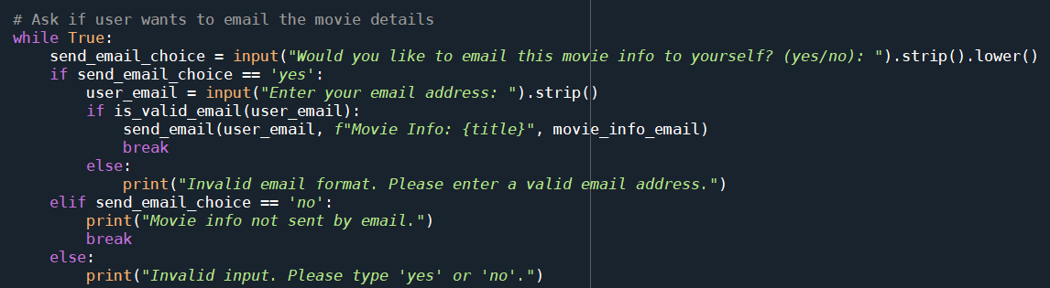
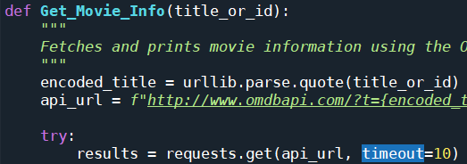
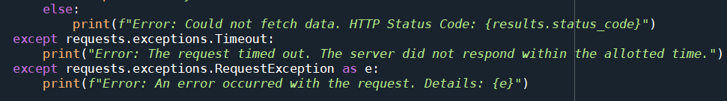
Document One Error Encountered
What was the error?
1. Any inappropriate response isn’t processed
2. Request taking too long
Solving the problem
1. Added while True loop
2. Added timeout and print statement
Notes:
Ryan Pena (errors encountered)

Slide 9


Team Members
JESIAH OWENS
Email modules and OMDb API
CHRISTIAN SANDHOLM
Print statements and poster option (webbrowser)
EMILY WEINPEL
Tier List function, Ranking function, Main program
RYAN PENA
Error Handling, fixing up the code.
Notes:
Everyone

Slide 10
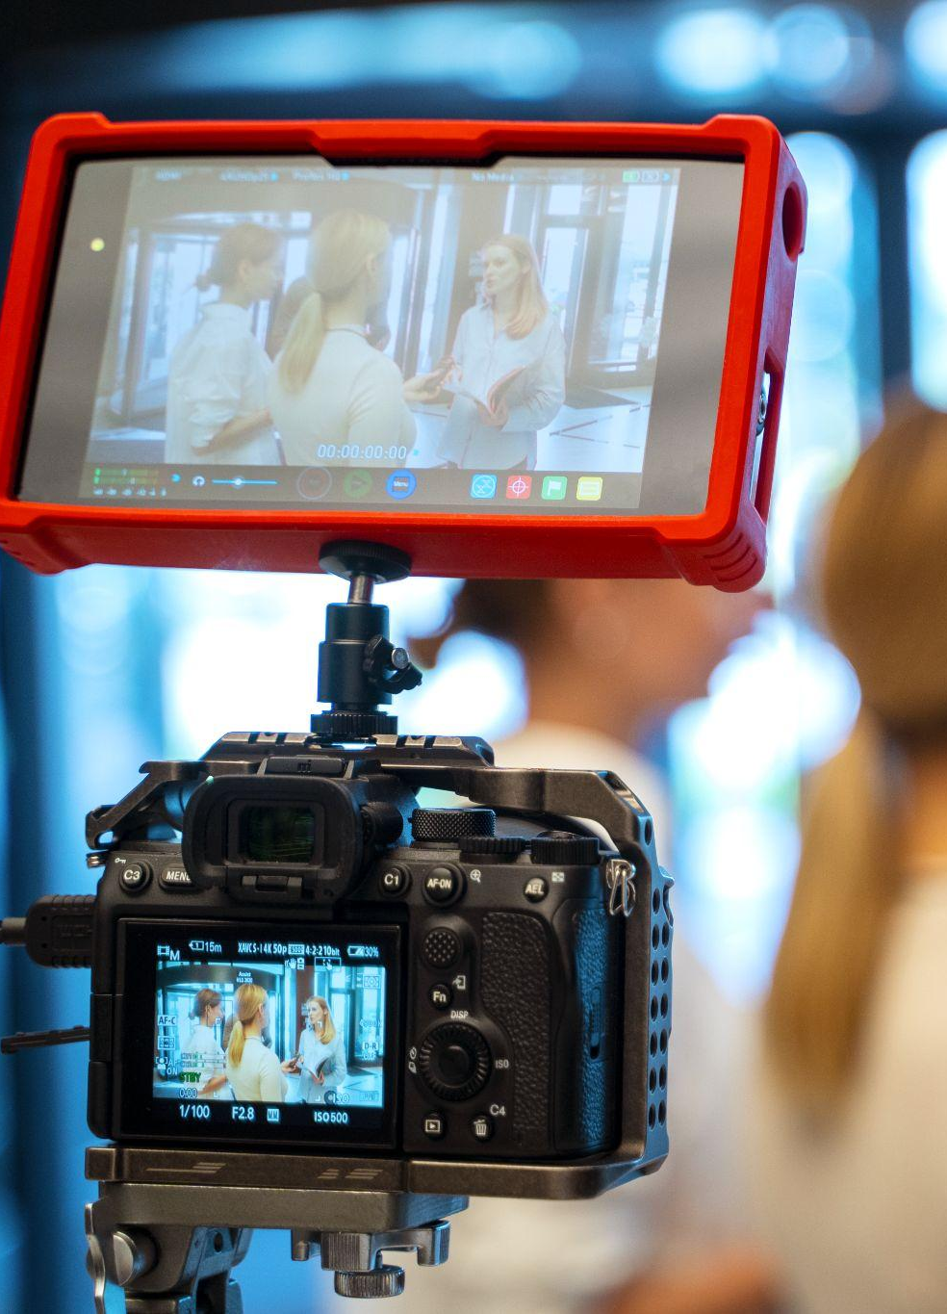
Related Documents
Color code print statements: https://www.studytonight.com/python-howtos/how-to-print-colored-text-in-python#google_vignette
OMDb API:
https://www.omdbapi.com/
Webbrowser Module:
https://docs.python.org/3/library/webbrowser.html
Chat GPT
https://docs.google.com/document/d/1BOKPqtKjcprQqgiiPI8LcRRFefwFiVrwyngo44_C-E0/edit?usp=sharing
Notes:
Jesiah

Slide 11



Questions?

